Slide 1
SQL Server PIV T Operators
Transforming Data Using the
T-SQL PIVOT/UNPIVOT operators

Slide 2

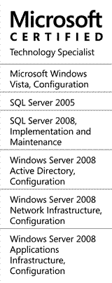


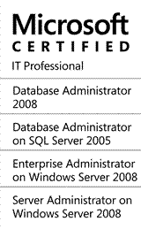


Who am I?
Notes:
My last name is pronounced “foo-SHAY,” though I respond to a number of pronunciations.

Slide 3
Presentation Overview
Ground Rules
What is a pivot?
Converting Vertical Data to Horizontal
  The PIVOT clause
  A 2-column PIVOT
  A 3-column PIVOT
  Dynamic PIVOT
  Alternative ways to pivot data
  n-column PIVOT
Converting Horizontal Data to Vertical
  The UNPIVOT clause
  Alternative ways to unpivot data
  Multi-UNPIVOT

Slide 4
Ground Rules…
The PIVOT operators are T-SQL OLTP-based keywords. This presentation will not involve SQL Analysis cubes.
PIVOT is not a replacement to the GROUP BY predicate
Oracle (11g and above) has a similar concept, but will not be discussed in-depth here.
Database compatibility of 90+ (SQL 2005)

Slide 5

The set-up…
Server “LOUSISWPS130”
Primary Contact: Kevin
Secondary Contact: Jeff
How could this be represented as data?
Notes:
Servers have a primary and secondary contact. At most one person can be a given contact.
I am part-owner of a server named LOUSISWPS130, and this needs to be documented as data inside some database.

Slide 6
ServerName | PropertyName | PropertyValue
LOUSISWPS130 | Primary Contact | Kevin
LOUSISWPS130 | Secondary Contact | Jeff
Notes:
Alright, so there it is… but is that the only way to store this?

Slide 7
Same data, different perspectives… (1/2)
ServerName | PropertyName | PropertyValue
LOUSISWPS130 | Primary Contact | Kevin
LOUSISWPS130 | Secondary Contact | Jeff
ServerName | Primary Contact | Secondary Contact
LOUSISWPS130 | Kevin | Jeff
One piece of truth per line
One piece of truth per x/y position
Vertical Data
Horizontal Data
- New contacts are added as rows
- New contacts are added as columns
Data storage
Reporting
Notes:
If I were to add a new contact/contact-type, I would append a row to the left-hand dataset, or add a column to the right-hand dataset

Slide 8
Same data, different perspectives… (2/2)
ServerName | PropertyName | PropertyValue
LOUSISWPS130 | Primary Contact | Kevin
LOUSISWPS130 | Secondary Contact | Jeff
ServerName | Primary Contact | Secondary Contact
LOUSISWPS130 | Kevin | Jeff
There will be times where your data must be converted:
A feed you import does not fit into your model
Data you export does not fit into the target model
Your data needs to fit in a one-page report
ETL purposes
Notes:
The real world does not conform to the same standards on storing data.
Data may need to be transformed to meet disparate business requirements, or to summarize

Slide 9

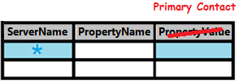

Converting Vertical Data to Horizontal
ServerName | PropertyName | PropertyValue
LOUSISWPS130 | Primary Contact | Kevin
LOUSISWPS130 | Secondary Contact | Jeff
ServerName | Primary Contact | Secondary Contact
LOUSISWPS130 | Kevin | Jeff
SELECT base.ServerName AS ServerName
, pri.PropertyValue AS [Primary Contact]
, sec.PropertyValue AS [Secondary Contact]
FROM
( SELECT DISTINCT ServerName
FROM [Table1]
) base
FULL OUTER JOIN
( SELECT ServerName, PropertyValue
FROM [Table1]
WHERE PropertyName = 'Primary Contact'
) pri
ON base.ServerName = pri.ServerName
FULL OUTER JOIN
( SELECT ServerName, PropertyValue
FROM [Table1]
WHERE PropertyName = 'Secondary Contact'
) sec
ON base.ServerName = sec.ServerName
Notes:
Let’s take a look at taking vertical data and turn it horizontal.
This could be accomplished using FULL OUTER JOINs
For each unique value in the PropertyName column, a new FULL OUTER JOIN is required
This is fine for a small number of columns…

Slide 10
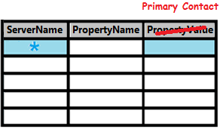
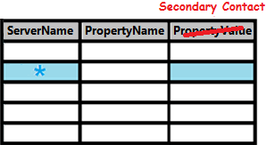
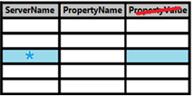
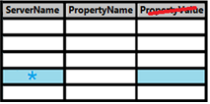

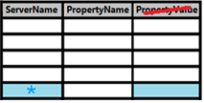
Converting Vertical Data to Horizontal
ServerName | PropertyName | PropertyValue
LOUSISWPS130 | Primary Contact | Kevin
LOUSISWPS130 | Secondary Contact | Jeff
LOUSISWPS130 | Tertiary Contact | Chris
LOUSISWPS130 | Access Approver | Dan
LOUSISWPS130 | Patching Approver | Mike
ServerName | Primary… | Secondary… | Tertiary… | Access… | Patching…
LOUSISWPS130 | Kevin | Jeff | Chris | Dan | Mike
SELECT base.ServerName AS ServerName
, pri.PropertyValue AS [Primary Contact]
, sec.PropertyValue AS [Secondary Contact]
, tri.PropertyValue AS [Tertiary Contact]
, access.PropertyValue AS [Access Approver]
, patch.PropertyValue AS [Patching Approver]
FROM
( SELECT DISTINCT ServerName
FROM [Table1]
) base
FULL OUTER JOIN
( SELECT ServerName, PropertyValue FROM [Table1] WHERE PropertyName = 'Primary Contact'
) pri
ON base.ServerName = pri.ServerName
FULL OUTER JOIN
( SELECT ServerName, PropertyValue FROM [Table1] WHERE PropertyName = 'Secondary Contact'
) sec
ON base.ServerName = sec.ServerName
FULL OUTER JOIN
( SELECT ServerName, PropertyValue FROM [Table1] WHERE PropertyName = Tertiary Contact'
) tri
ON base.ServerName = tri.ServerName
FULL OUTER JOIN
( SELECT ServerName, PropertyValue FROM [Table1] WHERE PropertyName = Access Approver'
) access
ON base.ServerName = access.ServerName
FULL OUTER JOIN
( SELECT ServerName, PropertyValue FROM [Table1] WHERE PropertyName = Patching Approver'
) patch
ON base.ServerName = patch.ServerName
Notes:
But what about when new requirements are added?
The code gets pretty unreadable.
There must be an easier way!

Slide 11

Notes:
What if I told you that Microsoft has already provided a way to make this easier?
And thankfully, there is no additional product you have to buy.

Slide 12


What is a pivot?
A pivot is a point or set of points, on the end of which
something rests and turns
something rotates or oscillates.
http://dictionary.reference.com/browse/pivoted?s=t
Notes:
A pivot is a theoretical point or set of points that stay stationary while something rotates or spins about it.
Some example motions are a see-saw, a door hinge, or my favorite example…

Slide 13

Torque / Force
Pivot
Notes:
The example of the wrench turning a bolt will be used for demonstrative purposes against data.

Slide 14

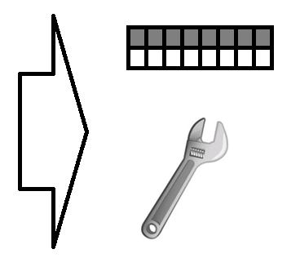

“Imagine” how this would apply to data
Less rows, more columns
Vertical data
Horizontal data
Notes:
In this oversimplified demonstration, what if I could take a wrench and rotate that data?
Look how we get more columns, and less “data”.
This is not quite the result, but the rotation will be helpful to explain later.

Slide 15

The PIVOT operator promotes data to column headers
Notes:
We’ll depict the PIVOT as a clockwise function to further describe this passage.
In every dataset, there is a box that represents neither a row header nor a column header… but it borders both columns and data.
Any data that will become a column header has to pass though the “magic square” to transcend functionality.
Coincidentally, the letter “P” is generally written using a clockwise circle.

Slide 16
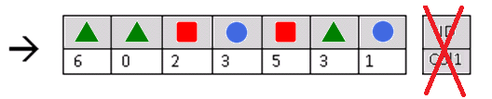
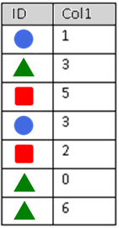

How a T-SQL PIVOT works
But what is ultimately presented back to the client?
Notes:
Let’s look at some basic arbitrary data.
The PIVOT operator takes the data and turns it clockwise, causing data to promote to the column headers. The original column headers are removed.
However, the rotated dataset is invalid because it uses repeating column headers.
To solve this, the data is temporarily condensed into “holding tanks” by column.
But what is ultimately presented back to the client?

Slide 17
Aggregates
An aggregate value is a solitary value that summarizes a list of values
Aggregate | Alphanumerics | Dates | Numerics | Datarows with NULLs | NULL-only records, or record-less
COUNT() | þ | þ | þ | Not counted towards final result | 0
MIN() | þ | þ | þ | Not counted towards final result | NULL
MAX() | þ | þ | þ | Not counted towards final result | NULL
SUM() |  |  | þ | Not counted towards final result | NULL
AVG() |  |  | þ | Not counted towards final result | NULL
* See Books Online for additional aggregates
See Books Online for additional aggregates, as well as any aggregate-to-datatype limitations.
Notes:
You must use an aggregate function, even if you have one value to aggregate.
Make sure your alphanumeric data is scrubbed before applying aggregates upon it.
Min/Max are usually not adequate aggregates for alphanumerics, e.g. a list of names, so make ensure you don’t have multiple values.

Slide 18
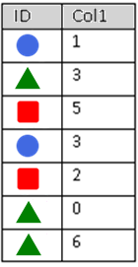
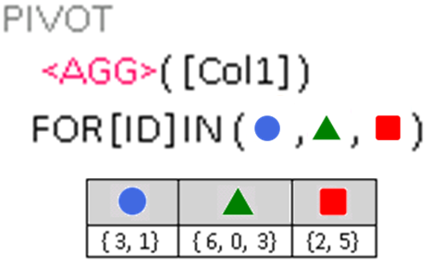
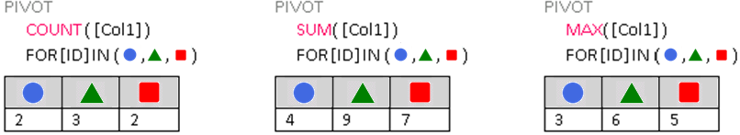
Notes:
This syntax is the main part of understanding the PIVOT statement.
Cannot stress this enough: Because values are aggregated, you get one and only one resulting value.
You cannot result with the raw array or list.

Slide 19



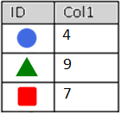



PIVOT LIKE/!= GROUP BY
PIVOT
GROUP BY
SELECT PivotResults.*
FROM (
SELECT ID, Col1 FROM dbo.Table_1
) AS RawData
PIVOT (
SUM(Col1)
FOR [ID]
IN ([ ],[ ],[ ])
) AS PivotResults
SELECT ID
, SUM(Col1) AS Col1
FROM dbo.Table_1
GROUP BY ID
Notes:
While both the PIVOT and GROUP BY clauses aggregate results, they do not share the same output structure, nor the same execution plan.

Slide 20

Breakdown of PIVOT statement (1/4)
Exactly one aggregate can be applied
Exactly one column can be aggregated
PIVOT (
SUM(Col1)
FOR [ID]
IN ([Circle], [Triangle], [Square])
)
Exactly one column’s values can be
pivoted into a column header
Table_1
PivotResults
Each “value-turned-column” (VTC)
Must be explicitly requested at compile-time.
  Sub-queries are not allowed here
  “But what if I don’t know them at compile-time?” Stay tuned
Must be enclosed in braces, if data contains spaces
Notes:
Microsoft calls them “pivoted columns,” but I will use “Values-Turned-Columns”
The glossary term “VTC” will be used elsewhere.

Slide 21
Breakdown of PIVOT statement (2/4)
SELECT
FROM (
SELECT ID, Col1 FROM dbo.Table_1
)
PIVOT (
SUM(Col1)
FOR [ID]
IN ([Circle], [Triangle], [Square])
)
Table_1
Original dataset
PivotResults

Slide 22
Breakdown of PIVOT statement (3/4)
SELECT
FROM (
SELECT ID, Col1 FROM dbo.Table_1
) AS RawData
PIVOT (
SUM(Col1)
FOR [ID]
IN ([Circle], [Triangle], [Square])
) AS PivotResults
Table_1
Both predicates must be named
PivotResults
Notes:
I use “RawData” and “PivotResults” to identify my predicates easily, but you can use any name.

Slide 23
Breakdown of PIVOT statement (4/4)
SELECT PivotResults.*
FROM (
SELECT ID, Col1 FROM dbo.Table_1
) AS RawData
PIVOT (
SUM(Col1)
FOR [ID]
IN ([Circle], [Triangle], [Square])
) AS PivotResults
*
Table_1
And then select the correct predicate
PivotResults
You cannot select this predicate, but its values will be part of the pivot results
Notes:
And select the correct predicate.
Congrats, you have transformed the dataset provided by “RawData” into a new dataset named “PivotResults.”
You cannot explicitly request any columns from RawData into the SELECT predicate.
You don’t have to qualify the * with “PivotResults”

Slide 24
Demo of a 2-column PIVOT
See attachments for source code

Slide 25
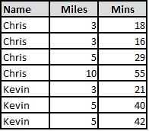
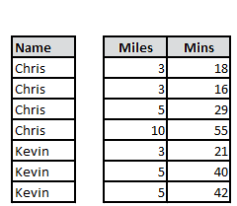
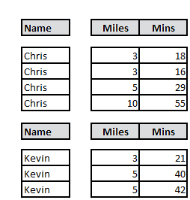

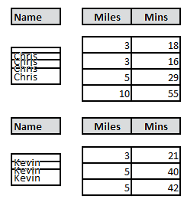
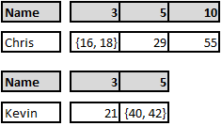
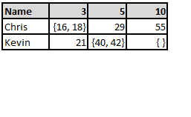

How a 3-column PIVOT works…
SELECT PivotResults.*
FROM (
SELECT [Name], Miles, Mins FROM ...
) AS RawData
PIVOT (
MIN(Mins)
FOR [Miles]
IN ([3], [5], [10])
) AS PivotResults
Notice this additional column (Name) is NOT in the PIVOT predicate

Slide 26
StoreID | [Quarter] | [Year] | Sales |  | DataEnteredBy
1 | 1 | 2011 | 10000 |  | Mary
1 | 2 | 2011 | 15000 |  | Chris
1 | 3 | 2011 | 17500 |  | Mary
1 | 4 | 2011 | 18000 |  | Mary
1 | 1 | 2012 | 22000 |  | Chris
1 | 2 | 2012 | 35000 |  | Bob
1 | 3 | 2012 | 40000 |  | Chris
1 | 4 | 2012 | 60000 |  | Mary
1 | 1 | 2013 | 38000 |  | Mary
1 | 2 | 2013 | 32000 |  | Chris
1 | 3 | 2013 | 45000 |  | Bob
1 | 4 | 2013 | 50000 |  | Chris
2 | 1 | 2012 | 20000 |  | Kim
2 | 2 | 2012 | 15000 |  | Kim
2 | 3 | 2012 | 30000 |  | Kim
2 | 4 | 2012 | 8000 |  | Lee
2 | 1 | 2013 | -3000
3 | 2 | 2013 | 50000 |  | Jerry
3 | 3 | 2013 | 30000 |  | Jerry
3 | 4 | 2013 | 50000 |  | Bill

Slide 27
Demo of a 3-column PIVOT
See attachments for source code

Slide 28
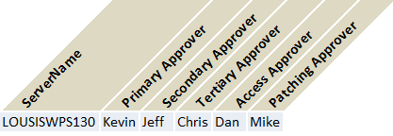


ServerName | PropertyName | PropertyValue
LOUSISWPS130 | Primary Contact | Kevin
LOUSISWPS130 | Secondary Contact | Jeff
LOUSISWPS130 | Tertiary Contact | Chris
LOUSISWPS130 | Access Approver | Dan
LOUSISWPS130 | Patching Approver | Mike
The FULL OUTER JOIN method…
The PIVOT method…
SELECT base.ServerName AS ServerName
, pri.PropertyValue AS [Primary Contact]
, sec.PropertyValue AS [Secondary Contact]
, tri.PropertyValue AS [Tertiary Contact]
, access.PropertyValue AS [Access Approver]
, patch.PropertyValue AS [Patching Approver]
FROM
( SELECT DISTINCT ServerName FROM [Table1]
) base
FULL OUTER JOIN
( SELECT ServerName, PropertyValue FROM [Table1] WHERE PropertyName = 'Primary Contact'
) pri
ON base.ServerName = pri.ServerName
FULL OUTER JOIN
( SELECT ServerName, PropertyValue FROM [Table1] WHERE PropertyName = 'Secondary Contact'
) sec
ON base.ServerName = sec.ServerName
FULL OUTER JOIN
( SELECT ServerName, PropertyValue FROM [Table1] WHERE PropertyName = Tertiary Contact'
) tri
ON base.ServerName = tri.ServerName
FULL OUTER JOIN
( SELECT ServerName, PropertyValue FROM [Table1] WHERE PropertyName = Access Approver'
) access
ON base.ServerName = access.ServerName
FULL OUTER JOIN
( SELECT ServerName, PropertyValue FROM [Table1] WHERE PropertyName = Patching Approver'
) patch
ON base.ServerName = patch.ServerName
SELECT PivotResults.*
FROM (
SELECT ServerName
, PropertyName
, PropertyValue
FROM [Table1]
) AS RawData
PIVOT (
MAX(PropertyValue)
FOR [PropertyName]
IN ([Primary Contact]
, [Secondary Contact]
, [Tertiary Contact]
, [Access Approver]
, [Patching Approver])
) AS PivotResults
Notes:
So back to our original example, which is a 3-column PIVOT
As long as I’m guaranteed one value per contact type

Slide 29
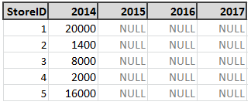
How do I manage my VTCs? (1/3)
Option 1: Explicitly request the ones of interest; Provision for extras
PIVOT (
SUM(Sales)
FOR [Year]
IN ([2014],
[2015],
[2016],
[2017]
)
Supported by ad-hoc queries
Supported by stored procedures
Supported by views

Slide 30
How do I manage my VTCs? (2/3)
Option 2: Use dynamic SQL (with cursor)
DECLARE @VTCNames varchar(MAX); SET @VTCNames = ''
DECLARE @SQLStmt varchar(MAX); SET @SQLStmt = ''
SET @SQLStmt = @SQLStmt + ' SELECT PivotResults.* '
SET @SQLStmt = @SQLStmt + ' FROM ( ... ) AS RawData '
SET @SQLStmt = @SQLStmt + ' PIVOT ( '
SET @SQLStmt = @SQLStmt + ' SUM(Sales) '
SET @SQLStmt = @SQLStmt + ' FOR [Year] '
SET @SQLStmt = @SQLStmt + ' IN (' + @VTCNames + ')'
SET @SQLStmt = @SQLStmt + ' ) AS PivotResults'
SET @SQLStmt = @SQLStmt + ' ORDER BY 1 ASC; '
EXEC(@SQLStmt)
Organize your columns into a logical order, affects output
DECLARE Cursor_VTCNames CURSOR LOCAL FAST_FORWARD FOR
SELECT DISTINCT [Year] FROM ... ORDER BY [Year]
DECLARE @variable varchar(50)
DECLARE @rowcount integer; SET @rowcount = 0
OPEN Cursor_VTCNames
FETCH NEXT FROM Cursor_VTCNames INTO @variable
WHILE @@FETCH_STATUS = 0
BEGIN
SET @rowcount = @rowcount + 1
IF @rowcount > 1 SET @VTCNames = @VTCNames + ','
SET @VTCNames = @VTCNames + '[' + @variable + ']'
FETCH NEXT FROM Cursor_VTCNames INTO @variable
END
CLOSE Cursor_VTCNames; DEALLOCATE Cursor_VTCNames
Only unique data to become columns in the output
(Probably should be indexed)
Ensures the first column is sorted, regardless of datatype
Supported by ad-hoc queries
Supported by stored procedures
Not supported by views
Notes:
Essentially, you’ll be constructing the PIVOT’s IN-clause.
You want to order the columns into a logical order, and only look for unique data
Pay attention to cursor options “local” and “fast_forward” for speed.

Slide 31

How do I manage my VTCs? (1/3)
Option 3: Don’t. Pivot for items that grow slowly over time.
PIVOT (
SUM(Sales)
FOR [StoreID]
IN ([1], [2],
[3], [4],
[5])
)
Supported by ad-hoc queries
Supported by stored procedures
Supported by views

Slide 32
Demo of the dynamic PIVOT (by Cursor)
See attachments for source code

Slide 33
How do I manage my VTCs? (2/3)
Option 2: Use dynamic SQL (with cursor)
DECLARE @VTCNames varchar(MAX); SET @VTCNames = ''
DECLARE @SQLStmt varchar(MAX); SET @SQLStmt = ''
SET @SQLStmt = @SQLStmt + ' SELECT PivotResults.* '
SET @SQLStmt = @SQLStmt + ' FROM ( ... ) AS RawData '
SET @SQLStmt = @SQLStmt + ' PIVOT ( '
SET @SQLStmt = @SQLStmt + ' SUM(Sales) '
SET @SQLStmt = @SQLStmt + ' FOR [Year] '
SET @SQLStmt = @SQLStmt + ' IN (' + @VTCNames + ')'
SET @SQLStmt = @SQLStmt + ' ) AS PivotResults'
SET @SQLStmt = @SQLStmt + ' ORDER BY 1 ASC; '
EXEC(@SQLStmt)
Organize your columns into a logical order, affects output
DECLARE Cursor_VTCNames CURSOR LOCAL FAST_FORWARD FOR
SELECT DISTINCT [Year] FROM ... ORDER BY [Year]
DECLARE @variable varchar(50)
DECLARE @rowcount integer; SET @rowcount = 0
OPEN Cursor_VTCNames
FETCH NEXT FROM Cursor_VTCNames INTO @variable
WHILE @@FETCH_STATUS = 0
BEGIN
SET @rowcount = @rowcount + 1
IF @rowcount > 1 SET @VTCNames = @VTCNames + ','
SET @VTCNames = @VTCNames + '[' + @variable + ']'
FETCH NEXT FROM Cursor_VTCNames INTO @variable
END
CLOSE Cursor_VTCNames; DEALLOCATE Cursor_VTCNames
Only unique data to become columns in the output
(Probably should be indexed)
Ensures the first column is sorted, regardless of datatype
Supported by ad-hoc queries
Supported by stored procedures
Not supported by views
Notes:
You don’t have to use a cursor

Slide 34
How do I manage my VTCs? (2/3)
Option 2: Use dynamic SQL (by FOR XML)
DECLARE @VTCNames varchar(MAX); SET @VTCNames = ''
DECLARE @Stmt varchar(MAX); SET @Stmt = ''
SET @Stmt = @Stmt + ' SELECT PivotResults.* '
SET @Stmt = @Stmt + ' FROM ( ... ) AS RawData '
SET @Stmt = @Stmt + ' PIVOT ( '
SET @Stmt = @Stmt + ' SUM(Sales) '
SET @Stmt = @Stmt + ' FOR [Year] '
SET @Stmt = @Stmt + ' IN (' + @VTCNames + ')'
SET @Stmt = @Stmt + ' ) AS PivotResults'
SET @Stmt = @Stmt + ' ORDER BY 1 ASC; '
EXEC(@Stmt)
SET @VTCNames = STUFF(
(
SELECT ', [' + Year + ']'
FROM ( SELECT DISTINCT Year FROM ... ) AS T
ORDER BY Year
FOR XML PATH(''), TYPE
).value('(./text())[1]', 'varchar(MAX)'), 1, 2, '');
Use XML transform to build a comma-separated, ordered, braced-value list
- A “pivot” in itself!
Ensures the first column is sorted, regardless of datatype
Supported by ad-hoc queries
Supported by stored procedures
Not supported by views
ý
Notes:
Essentially, you’ll be constructing the PIVOT’s IN-clause.
You want to order the columns into a logical order, and only look for unique data
Many thanks to MSDN forums for the XML conversion technique:
http://social.msdn.microsoft.com/Forums/sqlserver/en-US/2ab88114-be39-40f7-bed0-99d30b6fbc43/set-variable-to-distinct-array-returned-by-for-xml?forum=transactsql

Slide 35
Demo of the dynamic PIVOT (by FOR XML)
See attachments for source code

Slide 36
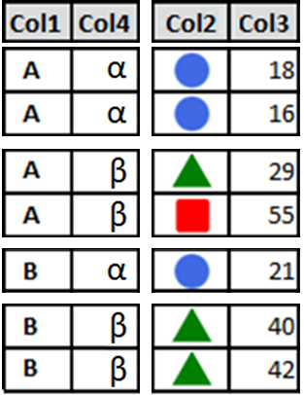
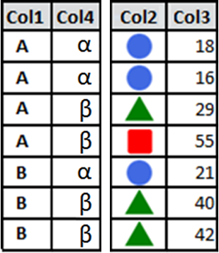
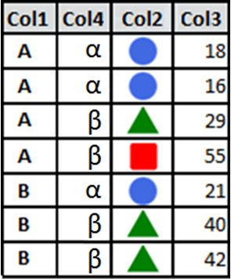
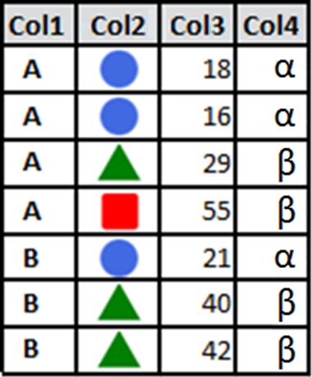

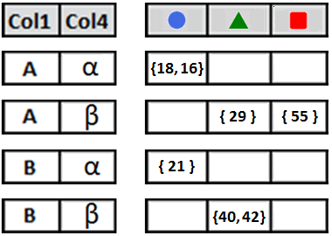
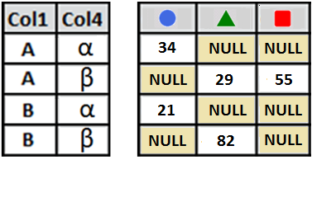
How a n-column PIVOT works…
Non-pivots ← → Pivots
SELECT PivotResults.*
FROM (
SELECT Col1, Col2, Col3, Col4
FROM ...
) AS RawData
PIVOT (
SUM(Col3)
FOR [Col2]
IN ( , , )
) AS PivotResults
Horizontal separation of “DISTINCT” combos
Notes:
Advanced explanation of the PIVOT

Slide 37
Questions about the PIVOT operator?
Coming up next → The UNPIVOT operator…

Slide 38


Converting Horizontal Data to Vertical
ServerName | Primary Contact | Secondary Contact
LOUSISWPS130 | Kevin | Jeff
ServerName | PropertyName | PropertyValue
LOUSISWPS130 | Primary Contact | Kevin
LOUSISWPS130 | Secondary Contact | Jeff
SELECT ServerName
, 'Primary Contact' AS PropertyName
, [Primary Contact] AS PropertyValue
FROM [Table2]
UNION ALL
SELECT ServerName
, 'Secondary Contact' AS PropertyName
, [Secondary Contact] AS PropertyValue
FROM [Table2]
+
UNION ALL...
UNION ALL...
UNION ALL...
Notes:
How could I take horizontal data and change it to vertical data?
Note that the data is going in the reverse direction.
One idea would be the UNION ALL statement.
Notice for each column on the right-hand dataset, I need another UNION ALL statement.

Slide 39
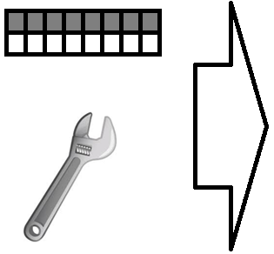

“Imagine” how this would apply to data
More rows, less columns
Horizontal data
Vertical data
Notes:
In this oversimplified demonstration, what if I could take a wrench and rotate that data?
Look how we get more columns, and less “data”.
This is not quite the result, but the rotation will be helpful to explain later.

Slide 40

An UNPIVOT demotes column headers into data
Notes:
For column headers to transcend to data elements, they need to move counter-clockwise though the magic square.
The curve of the letter “U” is written counter-clockwise as well (reminds you which operation to use based on rotation).

Slide 41
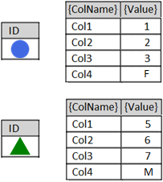

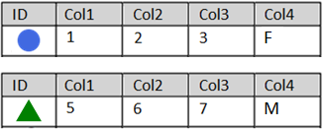
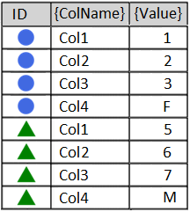
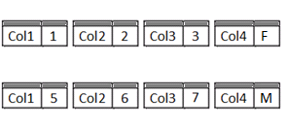
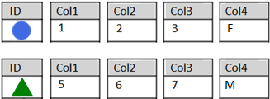
How an UNPIVOT works
…
Datatype?
Notes:
Let’s say Col1, Col2, and Col3 are tinyints, and Col4 is a one-letter string.
After the animation, what datatype would satisfy the merged values?

Slide 42
The Lowest Common Denominator
All run-time values merged by UNPIVOT must be able to fit in one common datatype without overflow (range of values), truncation (length of values), or collation (unicode / case-sensitivity) issues.
Col1 = int
Col2 = bigint
Resulting {Value} column may need to be defined as bigint
Col1 = int
Col2 = bigint
Col3 = varchar(10)
Resulting {Value} column may need to be varchar(20)
Col1 = int
Col2 = bigint
Col3 = nvarchar(50)
Col4 = char(2000)
or smaller…
Resulting {Value} column may need to be
nchar(2000)
Notes:
This is important..
Balance your current/future needs such that your common datatype continues to work, yet doesn’t bloat tempdb with unnecessary sizes.
Consider the theoretical minimums/maximums of the combined datatypes.
(A bigint could have a value of 9 quintillion which is 19 characters long when typed out. Add one more character for the negative sign.)
But if you’re not using extremes in your data (datatype maximums/minimums/lengths), could you go even smaller?

Slide 43
Breakdown of UNPIVOT statement (1/5)
Table_1
UNPIVOT (
PropertyValue
FOR PropertyName
IN (Col1, Col2, Col3, [Col4])
)
UnpivotResults
Decide on new column names
Braces required only when column name contains spaces
Notes:
Your new {ColName} and {Value} columns could be as simple as ‘PropertyName’ and ‘PropertyValue’

Slide 44
Breakdown of UNPIVOT statement (2/5)
Table_1
SELECT
FROM (
SELECT ID
, Col1
, Col2
, Col3
, Col4
FROM dbo.Table_1
)
UNPIVOT (
PropertyValue
FOR PropertyName
IN (Col1, Col2, Col3, Col4)
)
Original dataset
tinyint
UnpivotResults
char(1)
Notes:
Add my original dataset… oh yeah, but these datatypes clash.
What datatype do I need such that tinyints and char(1) can get along?

Slide 45
Breakdown of UNPIVOT statement (3/5)
Table_1
Convert to common
datatypes as necessary,
SELECT
FROM (
SELECT ID
, Convert(char(3),Col1) AS Col1
, Convert(char(3),Col2) AS Col2
, Convert(char(3),Col3) AS Col3
, Convert(char(3),Col4) AS Col4
FROM dbo.Table_1
)
UNPIVOT (
PropertyValue
FOR PropertyName
IN (Col1, Col2, Col3, Col4)
)
UnpivotResults
Re-alias column name to itself,
for the UNPIVOT mappings to work
Notes:
Without knowing the range of used values of the tinyint column, I might be able to get away with a char(2) or char(1).

Slide 46
Breakdown of UNPIVOT statement (4/5)
Table_1
SELECT
FROM (
SELECT ID
, Convert(char(3),Col1) AS Col1
, Convert(char(3),Col2) AS Col2
, Convert(char(3),Col3) AS Col3
, Convert(char(3),Col4) AS Col4
FROM dbo.Table_1
) AS RawData
UNPIVOT (
PropertyValue
FOR PropertyName
IN (Col1, Col2, Col3, Col4)
) AS UnpivotResults
UnpivotResults
Both predicates must be named
Notes:
Both predicates must be named with something

Slide 47
Breakdown of UNPIVOT statement (5/5)
Table_1
SELECT UnpivotResults.*
FROM (
SELECT ID
, Convert(char(3),Col1) AS Col1
, Convert(char(3),Col2) AS Col2
, Convert(char(3),Col3) AS Col3
, Convert(char(3),Col4) AS Col4
FROM dbo.Table_1
) AS RawData
UNPIVOT (
PropertyValue
FOR PropertyName
IN (Col1, Col2, Col3, Col4)
) AS UnpivotResults
*
UnpivotResults
And select the correct predicate
Notes:
Do I have to preface the star with UnpivotResults? No.

Slide 48


But what if there were NULLs in the data?
Table_1
?
SELECT *
FROM (
SELECT ID
, Convert(char(3),Col1) AS Col1
, Convert(char(3),Col2) AS Col2
, Convert(char(3),Col3) AS Col3
, Convert(char(3),Col4) AS Col4
FROM dbo.Table_1
) AS RawData
UNPIVOT (
PropertyValue
FOR PropertyName
IN (Col1, Col2, Col3, Col4)
) AS UnpivotResults
UnpivotResults
Notes:
When we look at the demo, we’ll find the “{Circle, Col3, NULL}” and “{Triangle, Col2, NULL}” records do not transfer to the UnpivotResults recordset.
You can force these records into the resultset by using the IsNull function to display some alternate text.
However, your alternate text will also be bound by the lowest common denominator rule from 6 slides ago.

Slide 49
Demo of an UNPIVOT
See attachments for source code

Slide 50
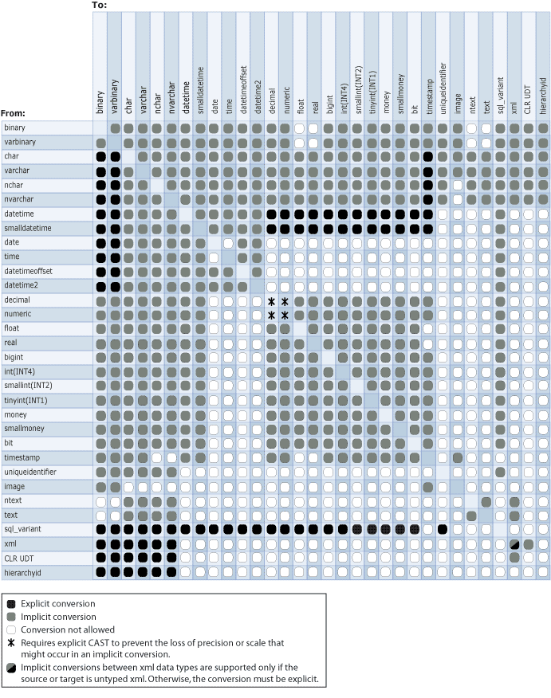
Can I use dynamic T-SQL with UNPIVOT?
Probably, but you may not want to!
Challenges:
  Number of columns to unpivot
  Datatype agreement
  Data lengths (Max available vs. used)
  “Do you want NULLs with that?”
http://msdn.microsoft.com/en-us/library/ms191530.aspx
Notes:
Based on the potential number of columns to unpivot, and the trickiness of calculating combined datatypes, no slide-deck presentation would do it justice.

Slide 51

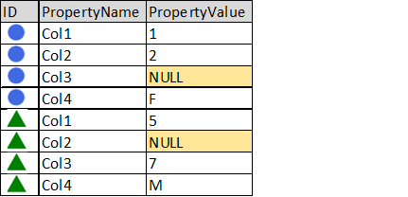
If time allows…
The CROSS APPLY-based unpivot
UNPIVOT
CROSS APPLY
SELECT *
FROM (
SELECT ID
, Convert(char(3),Col1) AS Col1
, Convert(char(3),Col2) AS Col2
, Convert(char(3),Col3) AS Col3
, Convert(char(3),Col4) AS Col4
FROM dbo.Table_1
) AS RawData
UNPIVOT (
PropertyValue FOR PropertyName
IN (Col1, Col2, Col3, Col4)
) AS UnpivotResults
SELECT *
FROM dbo.Table_1 AS u
CROSS APPLY (
VALUES ('Col1', Convert(char(3),u.Col1))
, ('Col2', Convert(char(3),u.Col2))
, ('Col3', Convert(char(3),u.Col3))
, ('Col4', Convert(char(3),u.Col4))
) AS x(PropertyName, PropertyValue);
SELECT ID, PropertyName, PropertyValue
FROM dbo.Table_1 AS u
CROSS APPLY (
VALUES ('Col1', Convert(char(3),u.Col1))
, ('Col2', Convert(char(3),u.Col2))
, ('Col3', Convert(char(3),u.Col3))
, ('Col4', Convert(char(3),u.Col4))
) AS x(PropertyName, PropertyValue);
Notes:
While both the UNPIVOT and CROSS APPLY force disparate values into one column, they do not share the same output structure.
Note how the columns are presented backwards between them?

Slide 52

The XML-based unpivot
If time allows…
DECLARE @MyString varchar(20) = '1 2 3 4 5'
DECLARE @MyString_XML XML
= CAST(
'<root><item>'
+ Replace(@MyString, ' ', '</item><item>')
+ '</item></root>'
AS XML)
SELECT t.value('.', 'varchar(max)') AS blah
FROM @MyString_XML.nodes('//root/item') AS a(t)

Slide 53
The SQL 2016 STRING_SPLIT-based unpivot
If time allows…
DECLARE @MyString varchar(20) = '1 2 3 4 5'
SELECT [value] AS [blah]
FROM STRING_SPLIT(@MyString, ' ')
Notes:
Requires the FROM clause
Database must be in SQL 2016+ compatibility mode
Notes:
This is a dataset-based keyword, not a string-manipulation keyword.
Therefore, you use the STRING_SPLIT keyword inside the FROM-clause

Slide 54
Demo of the XML-based & STRING_SPLIT-based unpivot
If time allows…
See attachments for source code

Slide 55
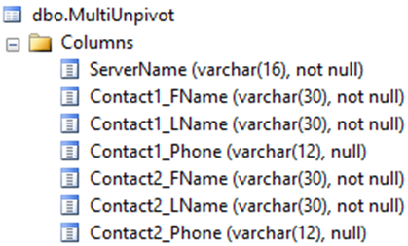
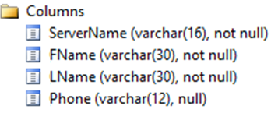
Multi-UNPIVOT
If time allows…
Normalizes hard-core denormalized data
Notes:
Once a dataset has been pivoted/unpivoted, it can be pivoted/unpivoted again…

Slide 56
If time allows…
SELECT *
FROM
( SELECT [ServerName]
,[Contact1_FName],[Contact1_LName],[Contact1_Phone]
,[Contact2_FName],[Contact2_LName],[Contact2_Phone]
, '|' AS '|'
FROM ...
) RawData

Slide 57
If time allows…
SELECT *
FROM
( SELECT [ServerName]
,[Contact1_FName],[Contact1_LName],[Contact1_Phone]
,[Contact2_FName],[Contact2_LName],[Contact2_Phone]
, '|' AS '|'
FROM ...
) RawData
UNPIVOT
( FName FOR element1 IN ([Contact1_FName], [Contact2_FName]) ) transform1
Notes:
Looks like we’re on the right path…

Slide 58

If time allows…
SELECT *
FROM
( SELECT [ServerName]
,[Contact1_FName],[Contact1_LName],[Contact1_Phone]
,[Contact2_FName],[Contact2_LName],[Contact2_Phone]
, '|' AS '|'
FROM ...
) RawData
UNPIVOT
( FName FOR element1 IN ([Contact1_FName], [Contact2_FName]) ) transform1
UNPIVOT
( LName FOR element2 IN ([Contact1_LName], [Contact2_LName]) ) transform2
Notes:
Oh no! What’s happening?

Slide 59
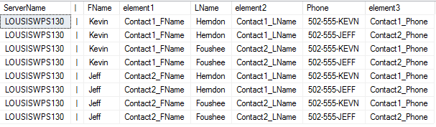
If time allows…
SELECT *
FROM
( SELECT [ServerName]
,[Contact1_FName],[Contact1_LName],[Contact1_Phone]
,[Contact2_FName],[Contact2_LName],[Contact2_Phone]
, '|' AS '|'
FROM ...
) RawData
UNPIVOT
( FName FOR element1 IN ([Contact1_FName], [Contact2_FName]) ) transform1
UNPIVOT
( LName FOR element2 IN ([Contact1_LName], [Contact2_LName]) ) transform2
UNPIVOT
( Phone FOR element3 IN ([Contact1_Phone], [Contact2_Phone]) ) transform3
Notes:
It’s like the UNPIVOTs are behaving like a CROSS JOIN!

Slide 60
If time allows…
SELECT *
FROM
( SELECT [ServerName]
,[Contact1_FName],[Contact1_LName],[Contact1_Phone]
,[Contact2_FName],[Contact2_LName],[Contact2_Phone]
, '|' AS '|'
FROM ...
) RawData
UNPIVOT
( FName FOR element1 IN ([Contact1_FName], [Contact2_FName]) ) transform1
UNPIVOT
( LName FOR element2 IN ([Contact1_LName], [Contact2_LName]) ) transform2
UNPIVOT
( Phone FOR element3 IN ([Contact1_Phone], [Contact2_Phone]) ) transform3
Notes:
Only two rows are important: where the “element” data matches on the first 8 characters.

Slide 61
If time allows…
transform3.*
SELECT *
FROM
( SELECT [ServerName]
,[Contact1_FName],[Contact1_LName],[Contact1_Phone]
,[Contact2_FName],[Contact2_LName],[Contact2_Phone]
, '|' AS '|'
FROM ...
) RawData
UNPIVOT
( FName FOR element1 IN ([Contact1_FName], [Contact2_FName]) ) transform1
UNPIVOT
( LName FOR element2 IN ([Contact1_LName], [Contact2_LName]) ) transform2
UNPIVOT
( Phone FOR element3 IN ([Contact1_Phone], [Contact2_Phone]) ) transform3
WHERE Left(element1, 8) = Left(element2, 8)
AND Left(element2, 8) = Left(element3, 8)
Notes:
Thankfully, since this is just a dataset… I can add a WHERE-clause

Slide 62
Demo of the Multi-UNPIVOT
If time allows…
See attachments for source code

Slide 63
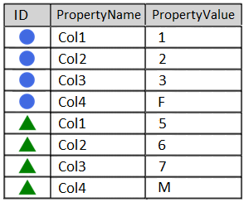
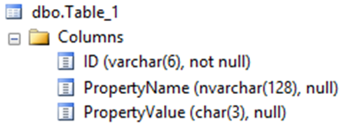
If time allows…
SELECT UnpivotResults.*
INTO dbo.Table_1
FROM (
SELECT ID
, Convert(char(3),Col1) AS Col1
, Convert(char(3),Col2) AS Col2
, Convert(char(3),Col3) AS Col3
, Convert(char(3),Col4) AS Col4
FROM dbo.[Unpivot]
) AS RawData
UNPIVOT (
PropertyValue
FOR PropertyName IN (Col1, Col2, Col3, Col4)
) AS UnpivotResults
Datatype?
Notes:
This slide is to show that the datatype of the “PropertyName” column – generated after an UNPIVOT – is an nvarchar(128).
This makes sense since column names have a limit of 128 characters.

Slide 64
Converting datetimes to fit in a varchar()
If time allows…
SELECT getdate() AS Original_Date
, Convert(varchar, getdate()) AS DateFormat1
, Convert(varchar(19), getdate(), 120) AS DateFormat2
, Convert(varchar(23), getdate(), 121) AS DateFormat3
Default varchar conversion
Keep your seconds
Keep your milliseconds
Notes:
If you have to convert your datetime values to string for the purposes of unpivot,
you may want to use the Convert function’s third parameter to preserve the data

Slide 65
Where do we go from here? (1/2)
Pivoted- and unpivoted recordsets can be further joined, aggregated, intersected, unioned, filtered, grouped, pivoted and unpivoted again
Computed columns can be pivoted and unpivoted if you compute them in the “RawData” portion of the query.
Scrub your data, and decide how you want to handle NULLs, before applying either

Slide 66
Where do we go from here? (2/2)
Pivoted/unpivoted recordsets can be used as SSRS datasets and SSIS datasources
Pivoting an unpivoted dataset -- or unpivoting a pivoted dataset -- rarely yields the original dataset
  PIVOT alters data by aggregating it
  UNPIVOT alters the datatype of combined data
With great power comes great responsibility

Slide 67

Presentation Summary
Learned what a pivot is
Learned about PIVOT keyword (for 2-, 3-, n-columns…)
Learned about dynamic PIVOT
Learned a way to “pivot” using FOR XML
Learned about UNPIVOT keyword
Learned about multi-UNPIVOT
Learned about data-themed “unpivot”
using XML, CROSS APPLY,
and STRING_SPLIT
Your anticipated level of excitement:
Notes:
PIVOT has been around since SQL Server 2005.

Slide 68
Questions?
Notes:
Thanks for reviewing my SQL Saturday presentation.

Slide 69
Thanks for listening!
Notes:
Thanks for reviewing my SQL Saturday presentation.

Slide 70
Presentation available…
https://github.com/jbfoushee

